Slide 1
SWO minilab
or Cloud Native Intro
Dmytro Borovyk

Slide 2
Agenda
Let’s talk K8S
Why K8S needed for SWO
Cloud Native Tools we need to know
Lab Environment
Future growth
Contribution Needed

Slide 3
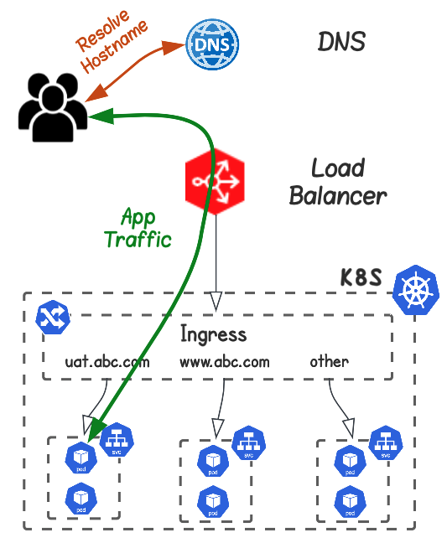
Pods
Containers run workloads on nodes in a Kubernetes cluster.
Services
How to access a set of Pods via a L4 load balancer.
Load Balancer
How to publish Kubernetes services
Ingress
How to access a set of Pods via a L7 load balancer (Hostname, URI)
DNS
How to resolve an IP address for services that run in K8s

Slide 4
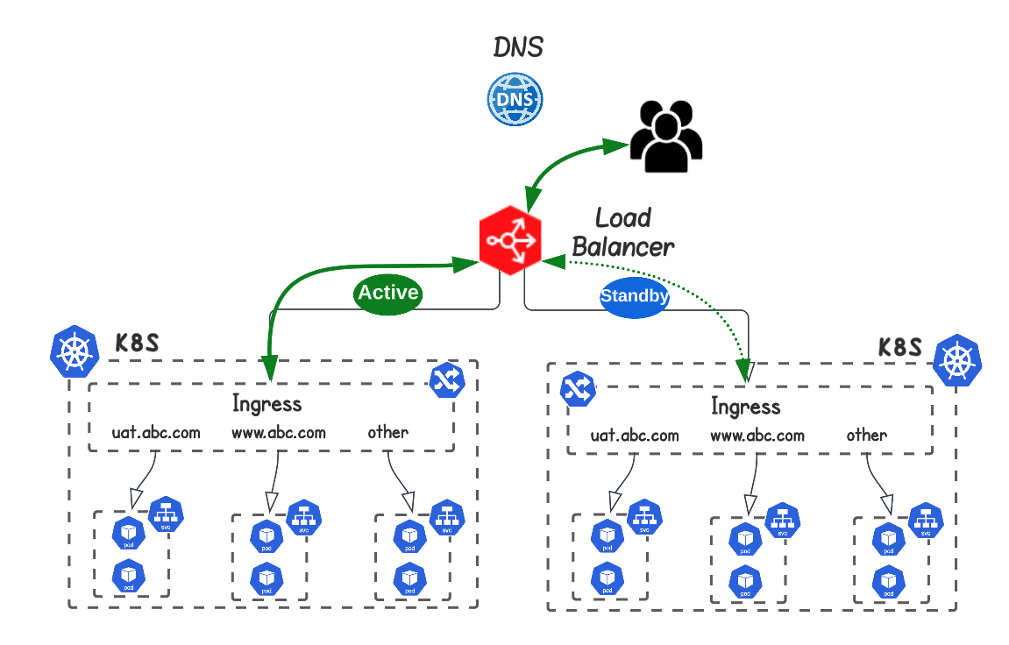
Multiple Ingress
Different Ingress Controller for different services/teams .
Canary Ingress
Test a new version of an Ingress Controller.
Multiple Clusters
Working as Active-Active or Active-Standby
Service Mesh
How services can communicate with each other while maintaining control.
Multiple Datacenters
Clusters being distributed across Datacenters

Slide 5
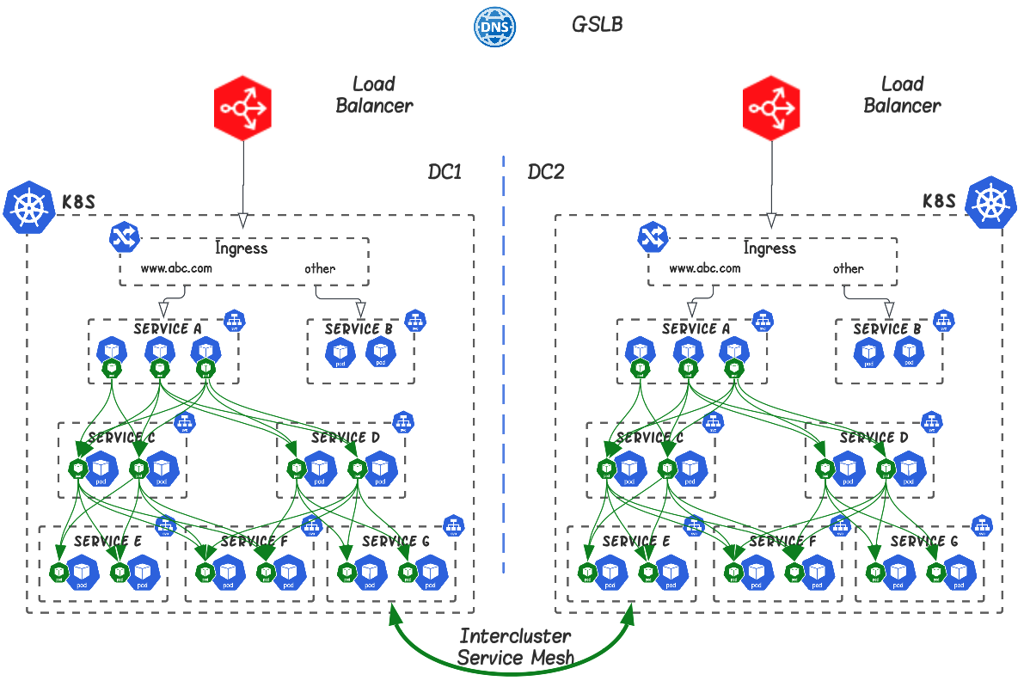
Multiple Ingress
Different Ingress Controller for different services/teams .
Canary Ingress
Test a new version of an Ingress Controller.
Multiple Clusters
Working as Active-Active or Active-Standby
Service Mesh
How services can communicate with each other while maintaining control.
Multiple Datacenters
Clusters being distributed across Datacenters

Slide 6
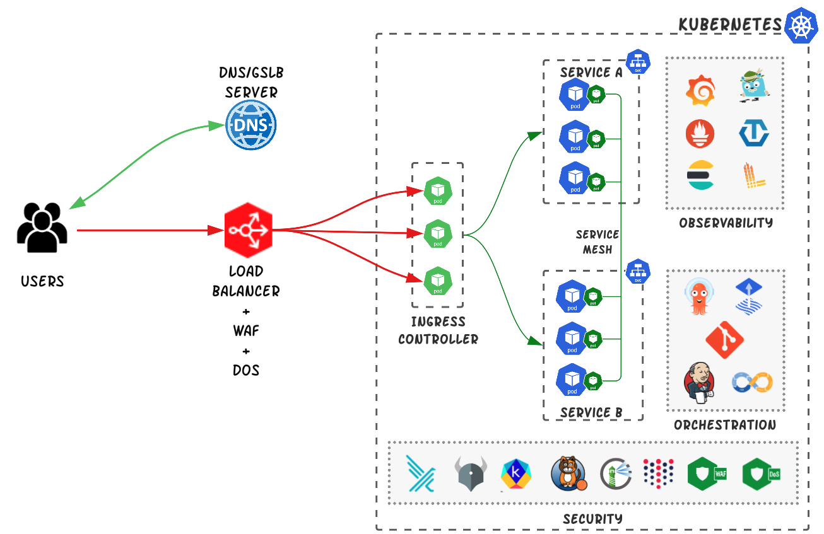
External
Internal

Slide 7
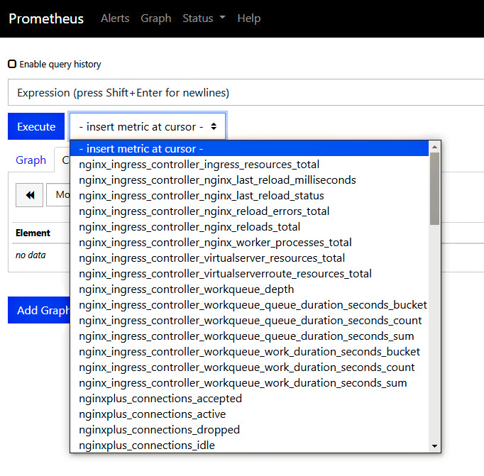
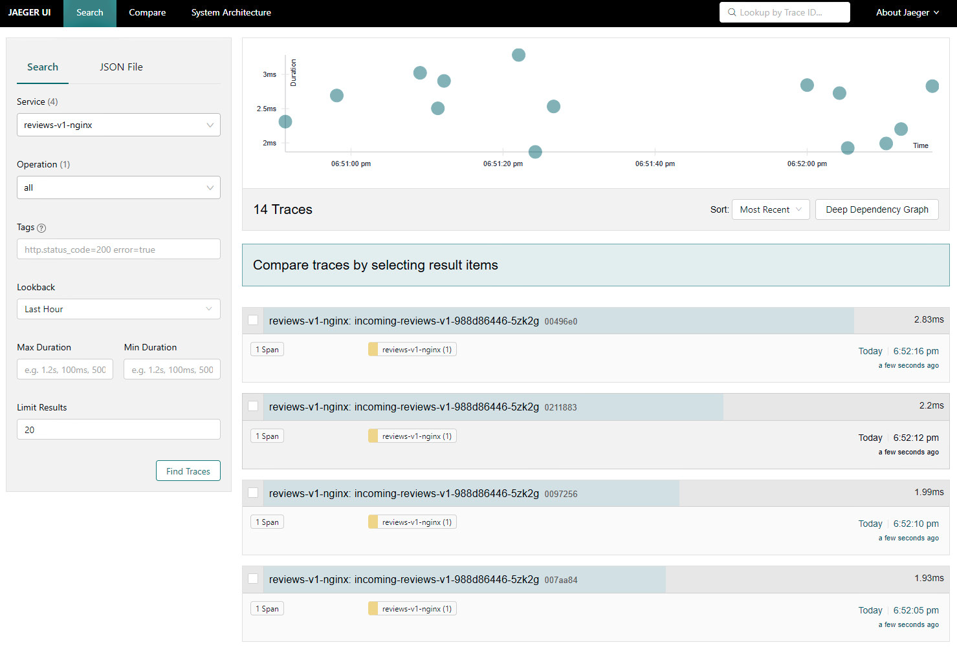
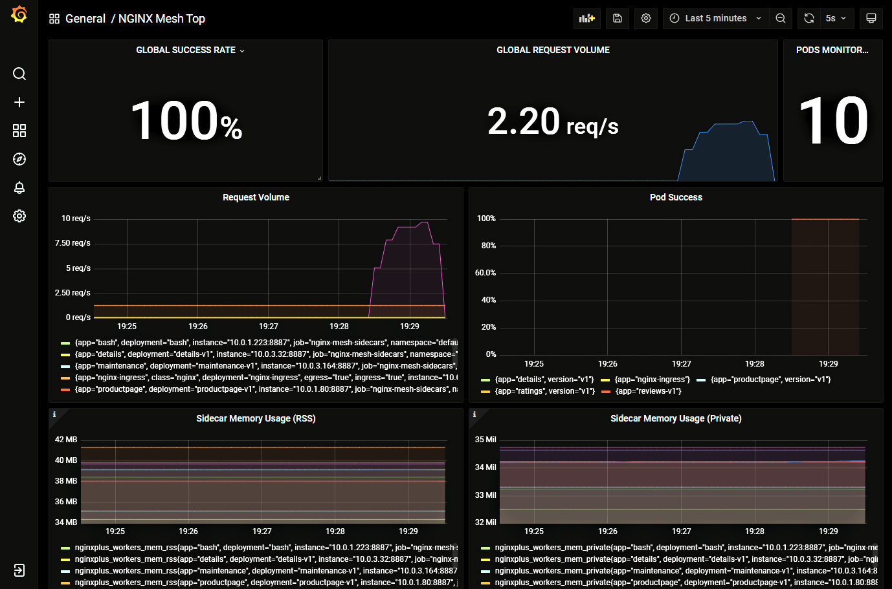
Prometheus monitoring and alerting
Jaeger distributed tracing
Grafana analytics and visualization

Slide 8
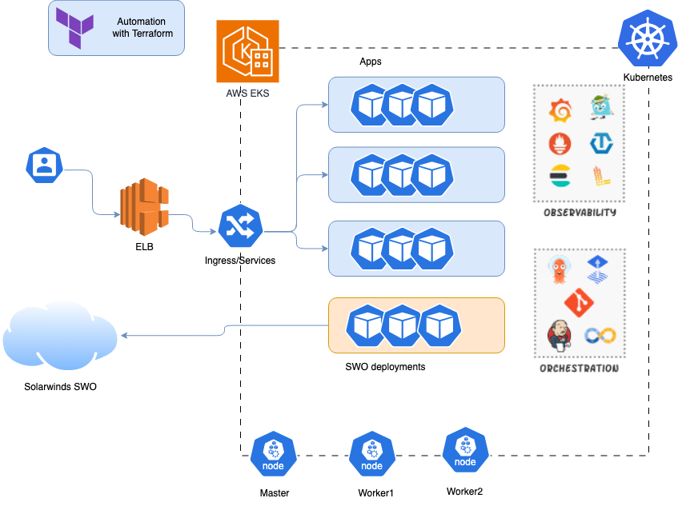
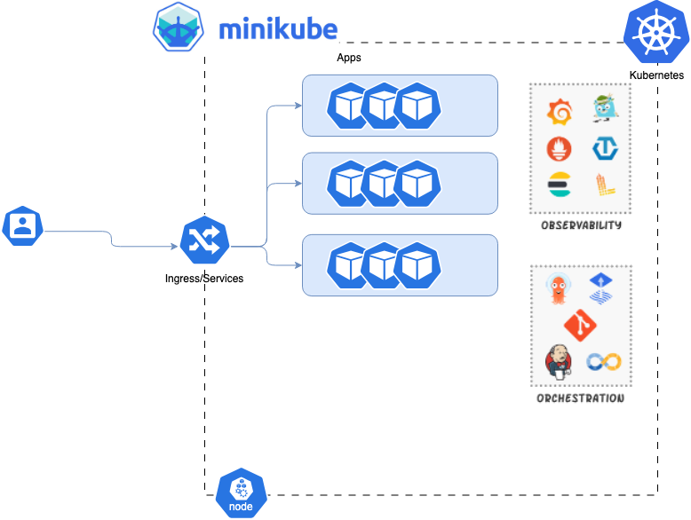
Lab
Local Lab – limited, no SWO
Cloud Lab – scalable, with SWO
https://github.com/dborovyk08/dbkube-monitoring/

Slide 9
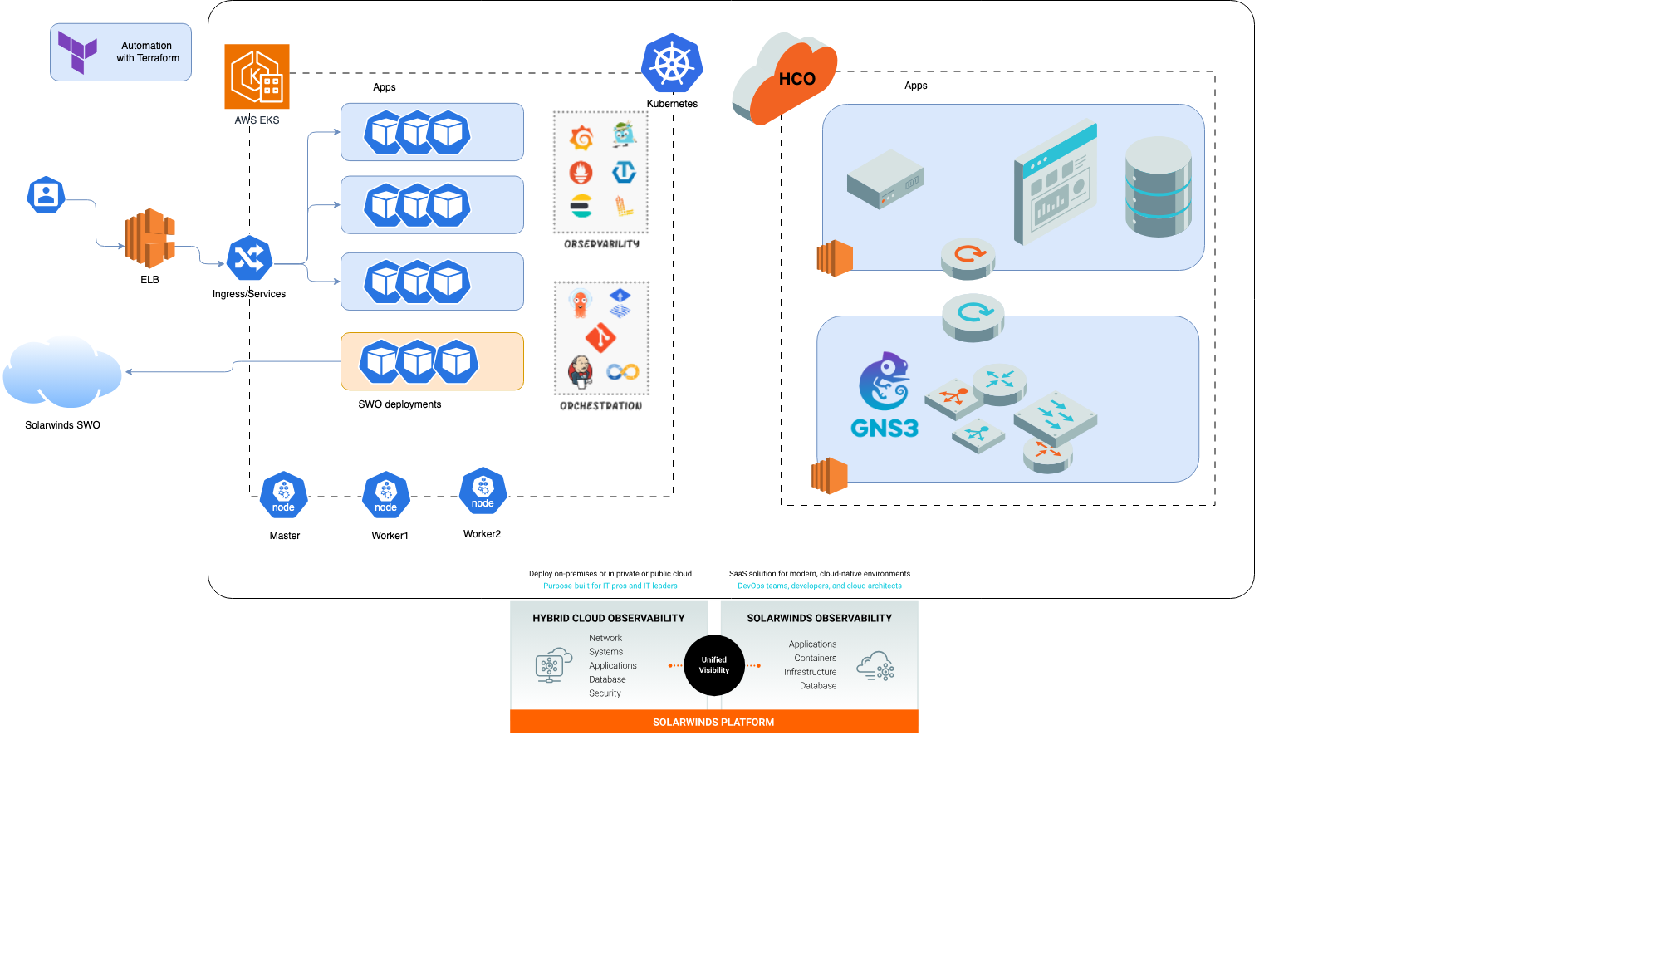
Lab
Cloud Lab with NICO and HCO

Slide 10
Purpose, Mission, and Values
Contribution is vital
Our purpose is to enrich the lives of the people we serve – employees, customers, shareholders, partners, and the communities in which we live.
Purpose
Our mission is to help customers accelerate business transformation through simple, powerful, and secure solutions designed for hybrid multi-cloud environments.
Mission
Values
Notes:
Public Package

